Slide 1
Capstone Project-3 Coronavirus Tweet Sentiment Analysis Team members AMOL RASAM KAMALUDDIN SHAIKH SHUBHAM JHA PRETESH

Slide 2
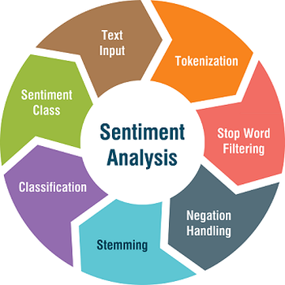
Content
● Problem Statement ● Data Summary
● EDA- Location Analysis ● Sentiment Analysis ● Daily Tweet count ● Monthly and weekly Tweet count
● Data Pre-Processing ● Top Words before and after Stemming ● Label Encoding
● ML Models and Metrics ● Challenges ● Conclusion

Slide 3
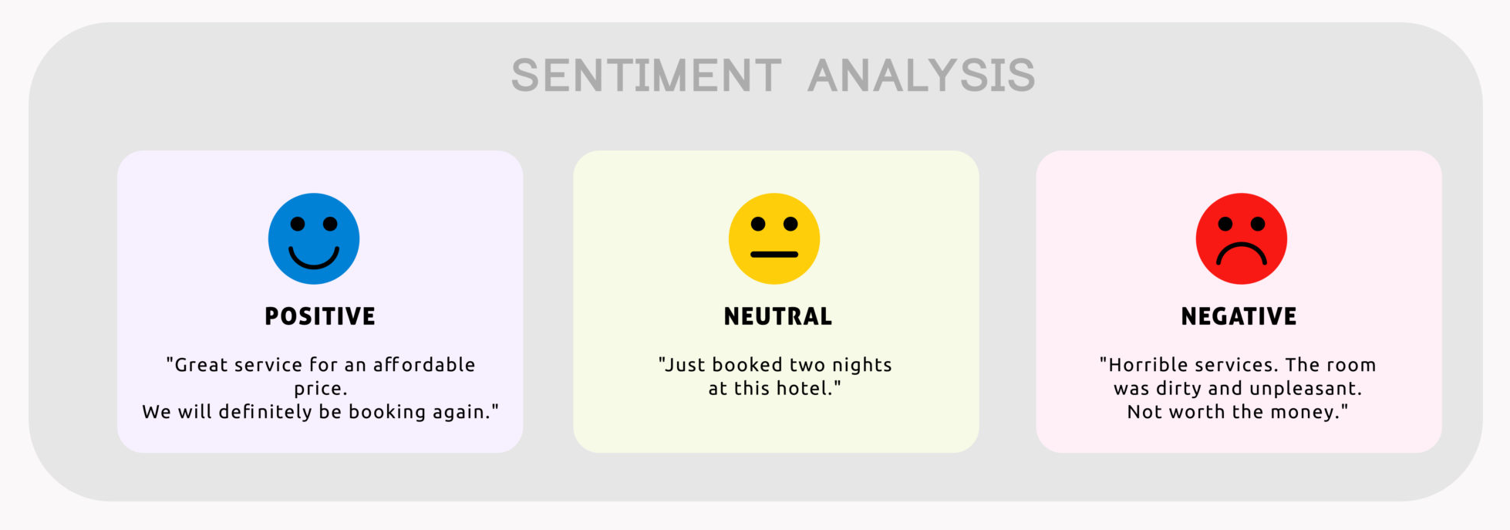
Problem Statement
This challenge asks you to build a classification model to predict the sentiment of COVID-19 tweets. The tweets have been pulled from Twitter and manual tagging has been done then.
The names and usernames have been given codes to avoid any privacy concerns. We are given information like Location, Tweet At, Original Tweet, and Sentiment.

Slide 4
Data Summary
The task is to build a classification model to predict the sentiment of Covid-19 related tweets. The dataset contains following columns:
Location: The location at which the tweet was made.
Tweet At: The date on which the tweet was made.
Original Tweet: This is the actual text of the tweet.
Sentiment: This is the sentiment of the tweet, which is manually tagged 41157 Rows Multiclass classification with 5 classes: Extremely Positive, Positive, Neutral, Negative, Extremely Negative.

Slide 5
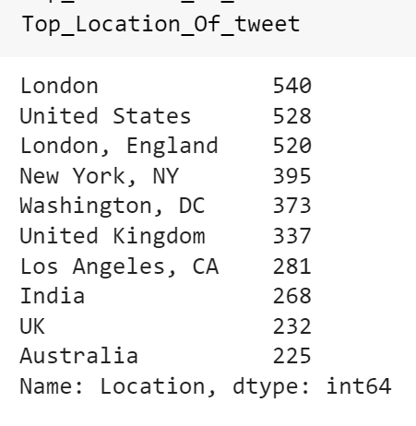
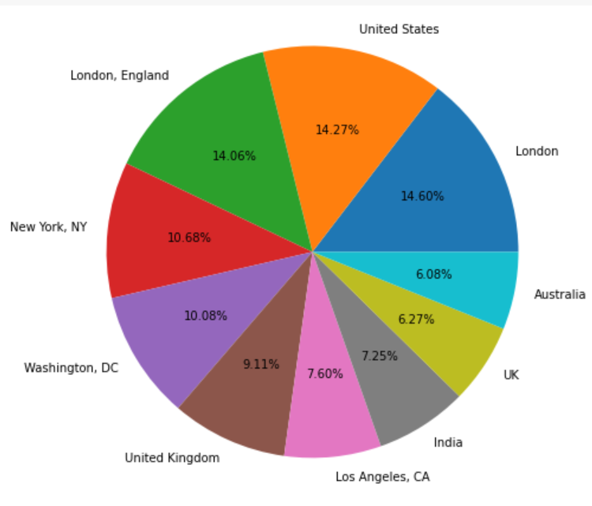
EDA – Location Analysis
We can see Most Tweets are coming from London. almost 28.66%.

Slide 6
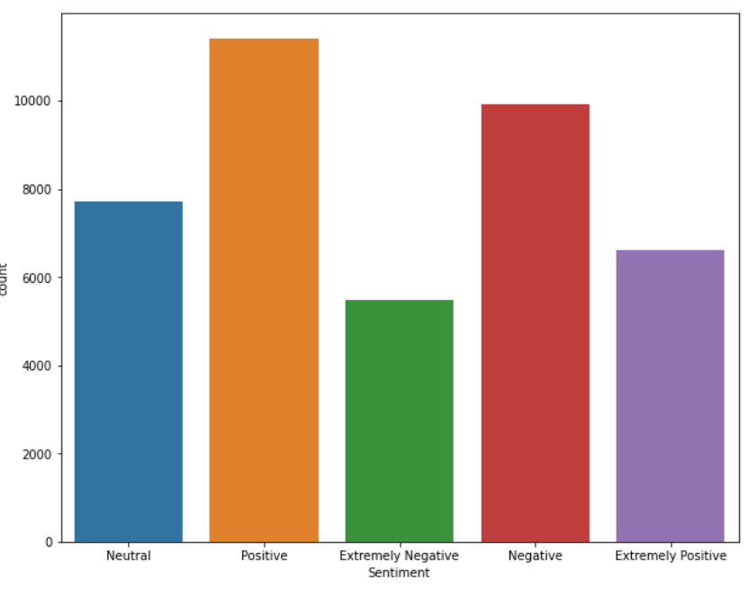
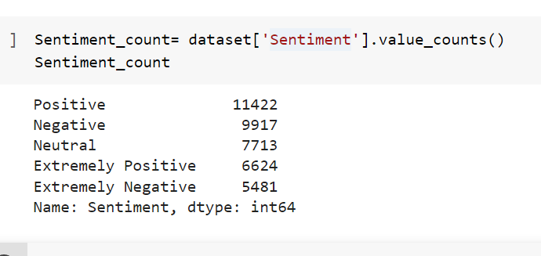
Sentiment Analysis
we know that most of the peoples are having positive sentiments about various issues shows us their optimism during pandemic times.

Slide 7
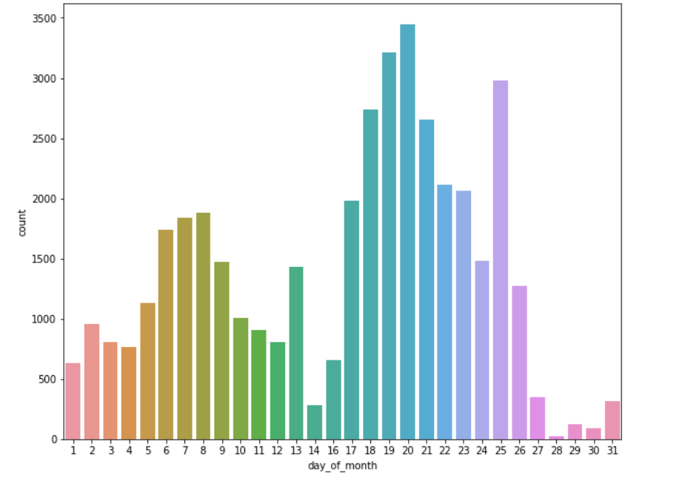
Daily Tweet Analysis
Most people tweeted during 18th to 25th in the month of March 2020.
We know the corona was spreading during this particular time and it was declared as National emergency by western countries and pandemic by WHO in the month of march.

Slide 8
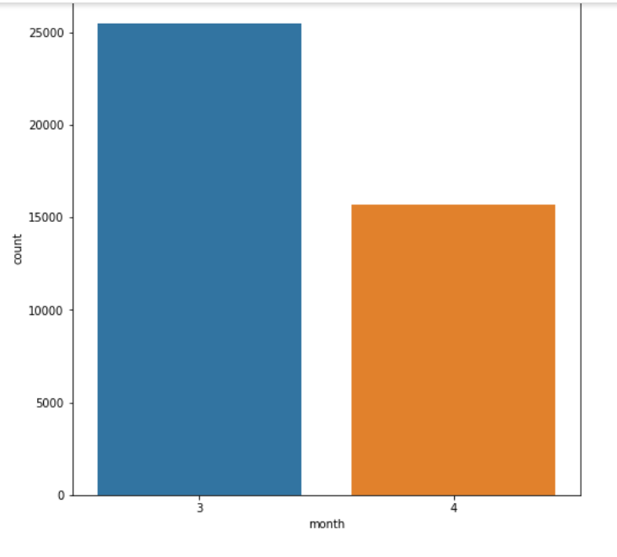
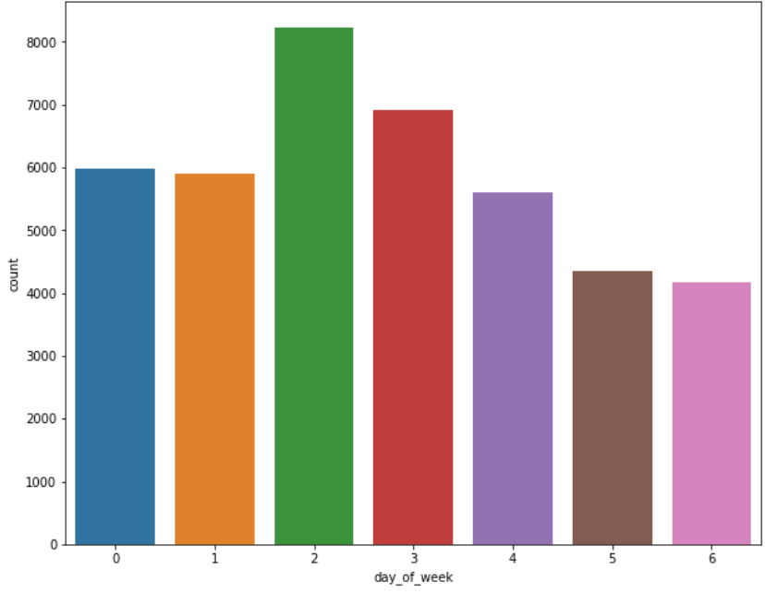
Monthly and Weekly Tweet Count
March is the month in which most number of tweets were tweeted – 25499 tweets.
Most people tweeted mostly during Tuesday and Wednesday of every week.

Slide 9
Data Pre-Processing
Steps taken to prepare the data
Removing Twitter Handles/ Usernames
Removing URL links
Removing # symbols and retaining the tags
Removing Punctuations and stop words
Removing short words
Tokenization and stemming

Slide 10
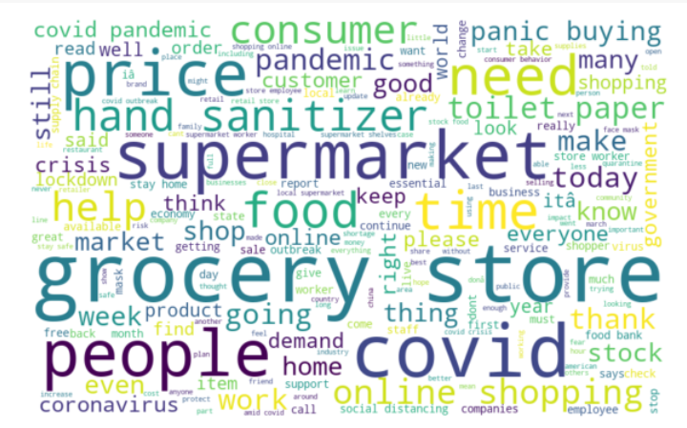
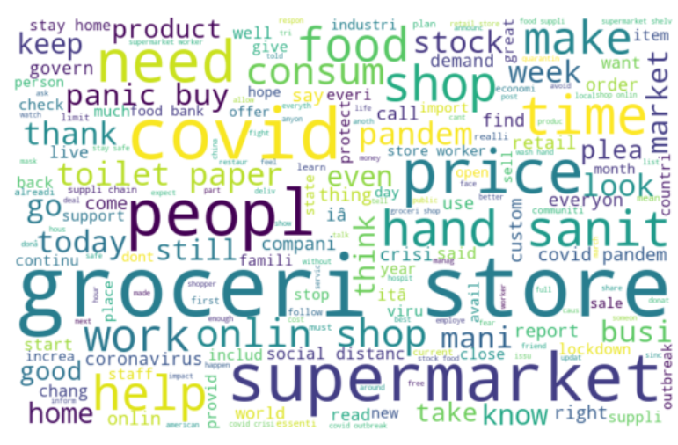
Top Word - Stemming
Top words – Before Stemming
Top words – After Stemming

Slide 11
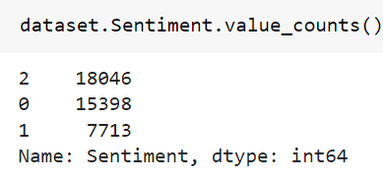
Label Encoding
We had 5 classes in our Sentiment column “ Extremely Positive, Positive, Neutral, Negative and Extremely Negative”. We converted it into 3 class “Positive, Neutral and Negative”.
It will give us better Accuracy and better overall understanding.
Extremely Positive = 2
Positive= 2
Neutral= 1
Negative= 0
Extremely Negative= 0

Slide 12
ML Models and Metrics
No | Model | Test accuracy | Precision | Recall
1 | Logistic Regression | 0.794866 | 0.794407 | 0.794866
4 | Random Forest | 0.771299 | 0.772827 | 0.771299
3 | Naive Bayes | 0.686751 | 0.692846 | 0.686751
5 | XGBoost | 0.686751 | 0.692846 | 0.686751
0 | Decision Tree | 0.499028 | 0.899430 | 0.499028
2 | K Nearest Neighbour | 0.340217 | 0.794275 | 0.340217
Logistic Regression model performed the best out of all these Models.

Slide 13
Challenges
Text Pre-Processing
Removing @users
Removing urls
Removing #tags
Vectorization
Label Encoding
Model Selection

Slide 14
Conclusion
As we have implemented six different models to predict the sentiment of COVID-19 Tweets. Logistic Regression, Random Forest Classifier, Decision Tree, Naive Bayes, K Nearest Neighbor and Xgboost Classifier.
Logistic Regression model performed the best among them. In this way, we can explore more from various textual data and tweets. Our models will try to predict the various sentiments correctly.
Our Model will help Government to make use of this information in policymaking as they can able to know how people are reacting to this new strain, what all challenges they are facing such as food scarcity, panic attacks, etc. Various profit organizations can make a profit by analyzing various sentiments as one of the tweets telling us about the scarcity of masks and toilet papers.

Slide 15
Thank You

